Slide 1
Anchor Modelling
Agile DBs
Sixth Normal Form databases!

Slide 2
Yes, there are normal forms after 3!

Slide 3
Yes, they can be useful!

Slide 4
Yes, I’m gonna explain myself! But first…

Slide 5

Steph Locke
Locke Data founder
Data Science & DataOps focus
Microsoft MVP
Author
@stefflocke

Slide 6
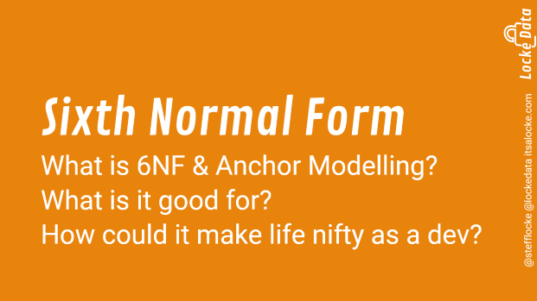
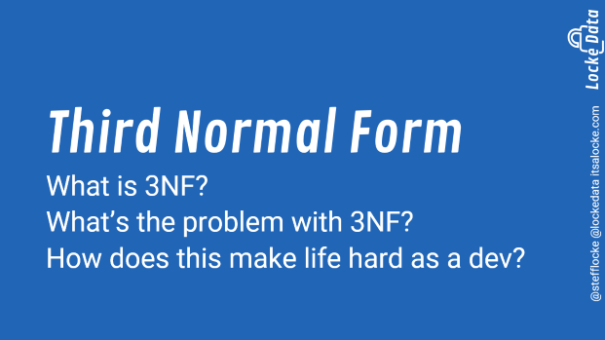
Agenda

Slide 7
Third Normal Form
What is 3NF?
What’s the problem with 3NF?
How does this make life hard as a dev?

Slide 8
Third Normal Form
No repeating groups per row
No partially dependent attributes
No dependencies except on the key

Slide 9
But WTF does that mean?

Slide 10
Let’s work from an example!

Slide 11
No normalisation aka denormalised
Table | Column | Sample value
Customer | CustomerID | 1
Customer | FirstName | Steph
Customer | Surname | Locke
Customer | Profession_Role | Data Scientist
Customer | Profession_HangsWith | Hipsters
Customer | Address_HouseNumber | 1
Customer | Address_Country_Name | Wales
Customer | Address_Country_Population | Many sheep
Customer | PurchaseHistory_Item1_Item | Beer
Customer | PurchaseHistory_Item1_Quantity | 5
Customer | PurchaseHistory_Item2_Item | NULL
Customer | PurchaseHistory_Item2_Quantity | NULL

Slide 12
Quiz time! What’s bad about that table?

Slide 13

What if I mis-spell Locke? How can I run an update?
People can only purchase two things!
So much repeating info!
Some info is dependent on other columns
Not all the info is about customers

Slide 14
Sixth Normal Form
What is 6NF & Anchor Modelling?
What is it good for?
How could it make life nifty as a dev?

Slide 15
Conclusion

Slide 16

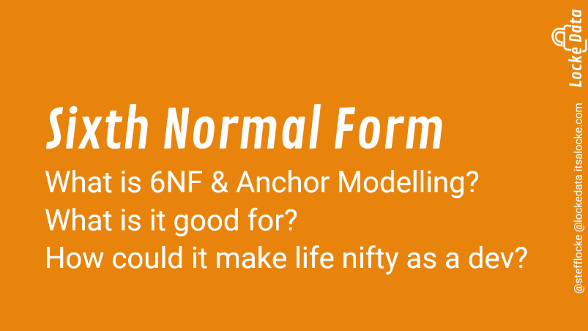

Slide 17
Thank you!
Thank you to the organisers, sponsors, and volunteers too!

Slide 18

Follow up
Q&A
Grab a card & sticker!
@stefflocke
itsalocke.com/talks
steph@itsalocke.com

